Slide 1





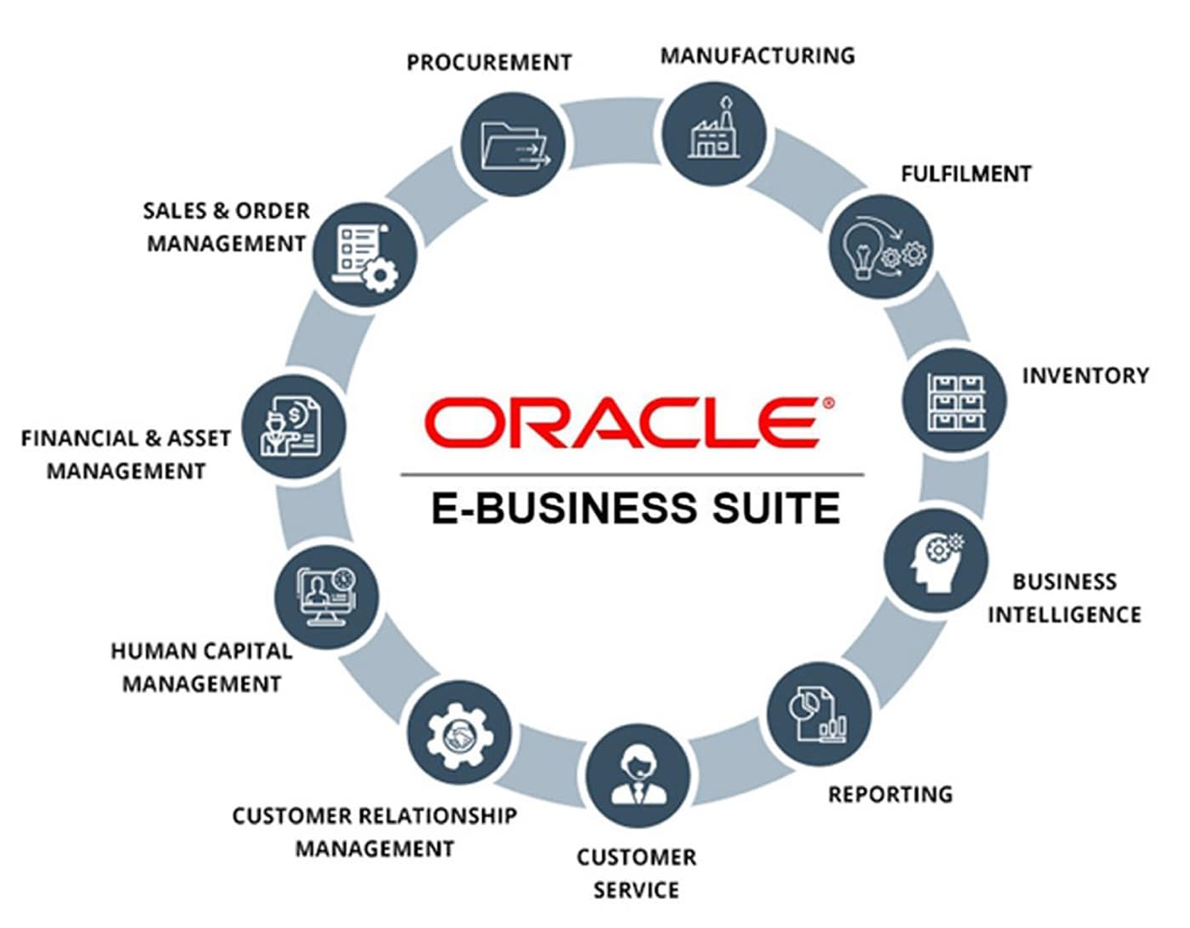
Oracle Procurement Process Implementation Project
ABC Pharmaceutical Company
Project Team Members:
Salma Fayez Elsayed
Karim Mohamed Talaat
Mohamed Elsayed Ismael
Abdel Zaher Mohamed Ahmed
Metwally Ibrahim Mohamed
Group: NXT21_ALX2_ERP3_G1
Instructor: Eng. Ahmed Gaber
Oracle Digital Supply Chain Management Track

Slide 2



Project Overview
Objective:
The objective of this project is to configure Oracle Procurement System in alignment with stakeholder requirements to efficiently manage procurement transactions for ABC Pharmaceutical Company. The configuration will ensure accurate maintenance of on-hand inventory balances and establish a material replenishment plan utilizing the Approved Supplier List (ASL) to streamline sourcing and supply chain operations.
Scope:
The project team will configure the procurement module in the Oracle EBS R12 system for ABC Pharmaceutical Company, and the scope will include system Configuration, Testing, Implementation and training.

Slide 3






Project outcomes
Based on stakeholder requirement, our team will configure a procurement module that fulfills customized procurement life cycle ensure delivering the following outcomes:
01
Purchase requisitions Creation, Approval and monitoring.
04
Material planning method (MIN-MAX)
02
RFQs, Quotations and Supplier selection
05
Material Receipt/Return
03
Purchase order Creation, Approval and Monitoring (Direct POs- POs From Requisitions – POs from Agreements)

Slide 4









Project milestones
Initiation & Analysis
Configuration and Integration with other Oracle modules
Testing and implementation
Training
Understand stakeholders business processes and their customized requirements those needed to be configured in Oracle procurement module.
Procurement module configuration setup and seamless integration with other Oracle modules such as Oracle HR, Financials and Inventory.
Conduct User Acceptance Testing (UAT) and actual implementation to ensure all configurations function as expected.
Provide training to end-users and administrators to ensure the effective use of the module.

Slide 5








Project Team
Rules
Salma Fayez Elsayed
Salma Fayez is a dedicated and detail-oriented clinical pharmacist. She worked in various settings, including community pharmacies, hospitals, and clinical environments.
Rule in Project: Project initiation/analysis, Supplier, RFQs and Quotations.
Karim Mohamed Talaat
Karim Mohamed is operation executive at freight forwarding company, he is responsible to arrange invoices and keep tracking of shipments.
Rule in Project: HRMS set up, purchasing requests implementation.
Mohamed Elsayed Ismael
Mohamed Ismail Is a Pharmacist with extensive experience in the Pharmaceutical products distribution and trading.
Rule in project: Inventory set up, ASL, material receipt and Return
Abdel Zaher Mohamed Ahmed
Abdelzaher Mohamed has experience in production and industrial engineering and quality controlling.
Rule in project: Sys admin Setup, Buyers, Approval Hierarchy and POs.
Metwally Ibrahim Mohamed
Metwally Ibrahim has extensive experience in production and planning at leading multinational organizations.
Rule in the project: Purchase set up, POs, Blanket agreements, Planning method

Slide 6




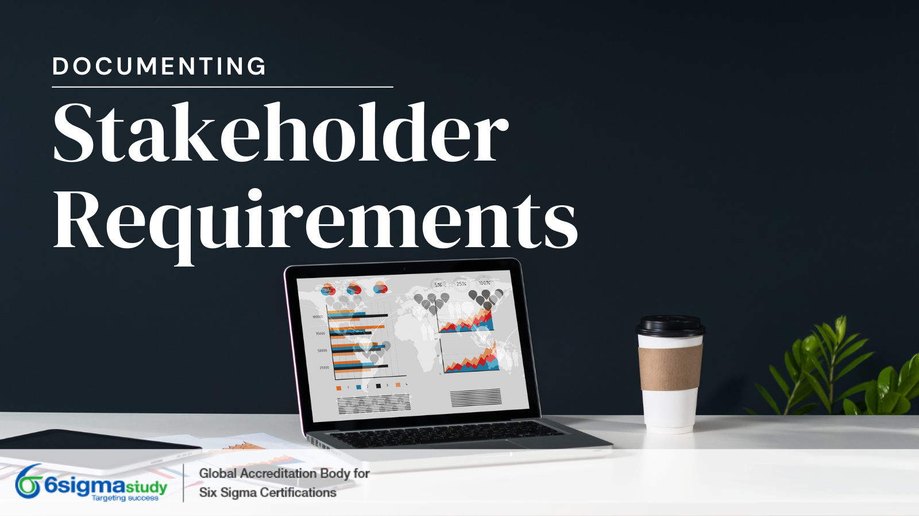
Stakeholders requirements:
1st Millstone
Project Initiation and Analysis
01
Establish an approved Supplier list
Understand from stakeholders the business processes and their customized requirements those needed to be configured in Oracle procurement module.
02
Create agreements with suppliers.
03
Create a planning method for purchase.
04
Identify purchase responsibilities and approval hierarchy
05
Deliver the project in 12 weeks from contract signing

Slide 7
2nd Millstone
Configuration of Procurement Module and Integration with other Oracle modules
Configuration Steps Of Procurement Module:
Administrator setup (Define Users, Responsibilities and Profile options)
HR and Financial setup.
Inventory setup.
Purchasing Setup.
In this step we will setup the Oracle features those required to establish procurement module and make integration with other Oracle modules such as Oracle HR, Financials and Inventory.

Slide 8
Configuration
2nd Millstone
System Administrator setup
(Responsibilities, Define Users and Profile options)

Slide 9
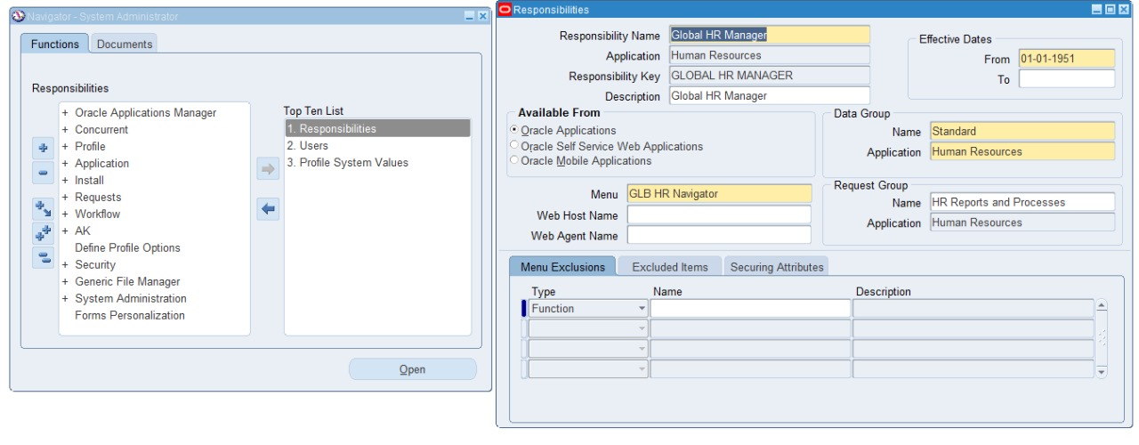
Configuration
2nd Millstone
Define Global HRMS manager
System administrator (Resp.)
Security → Responsibility → Define

Slide 10
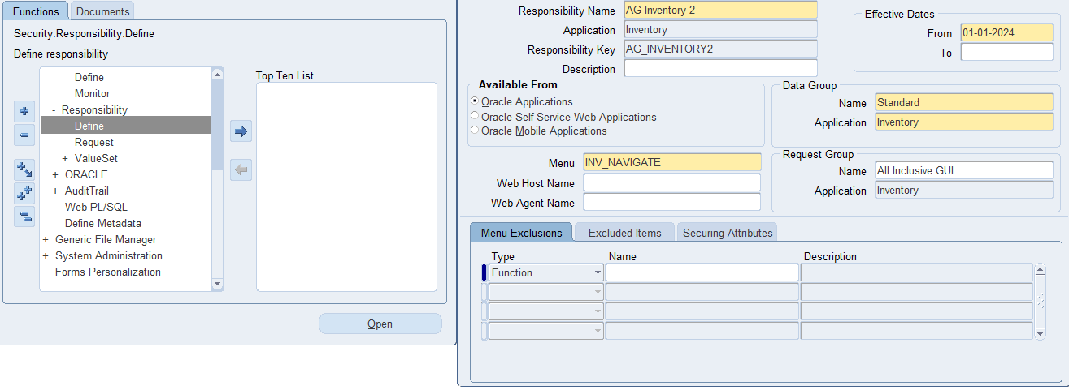
Configuration
2nd Millstone
Define Inventory responsibility
System administrator (Resp.)
Security → Responsibility → Define

Slide 11
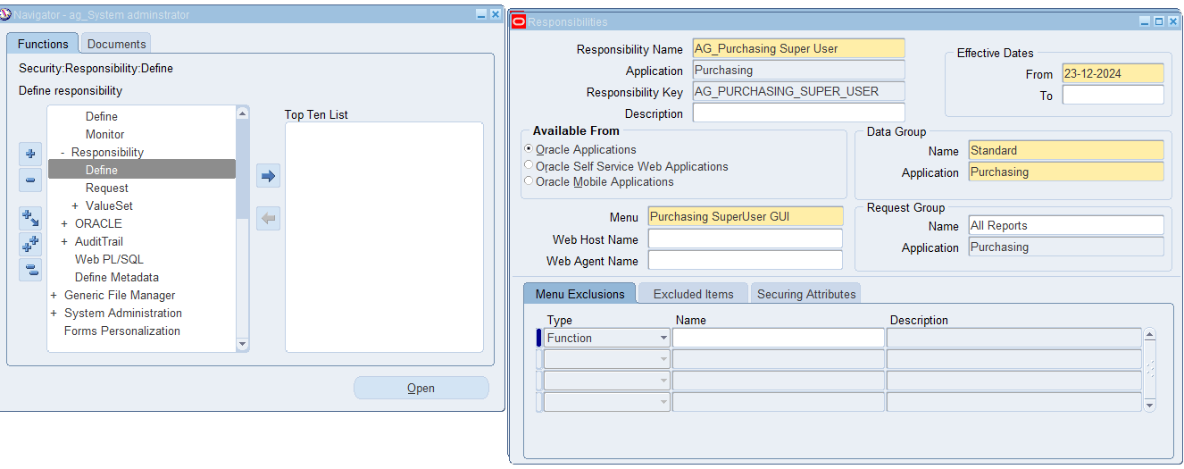
Configuration
2nd Millstone
Define Purchasing Responsibility
System administrator (Resp.)
Security → Responsibility → Define

Slide 12
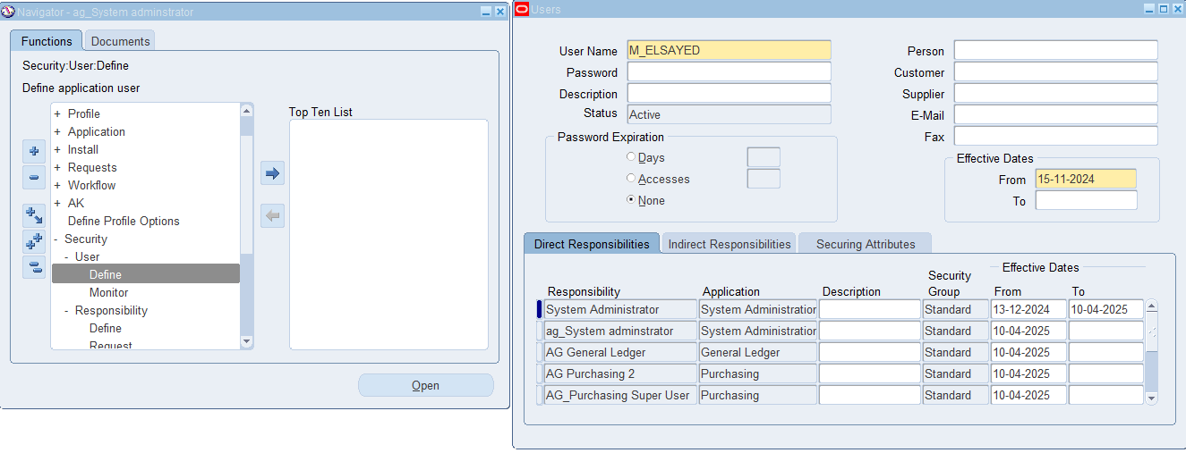
2nd Millstone
Configuration
Define User
System administrator (Resp.)
Security →User→ Define

Slide 13
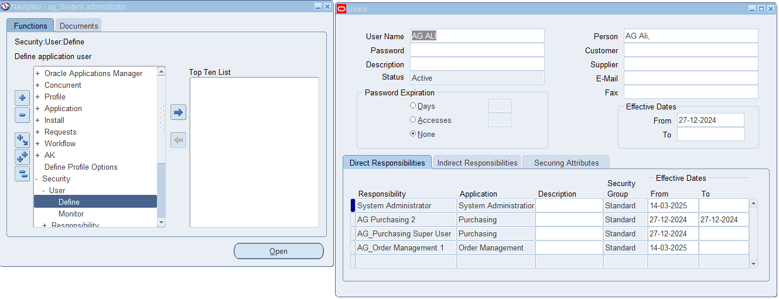
Configuration
2nd Millstone
Define User
System administrator (Resp.)
Security → User → Define

Slide 14
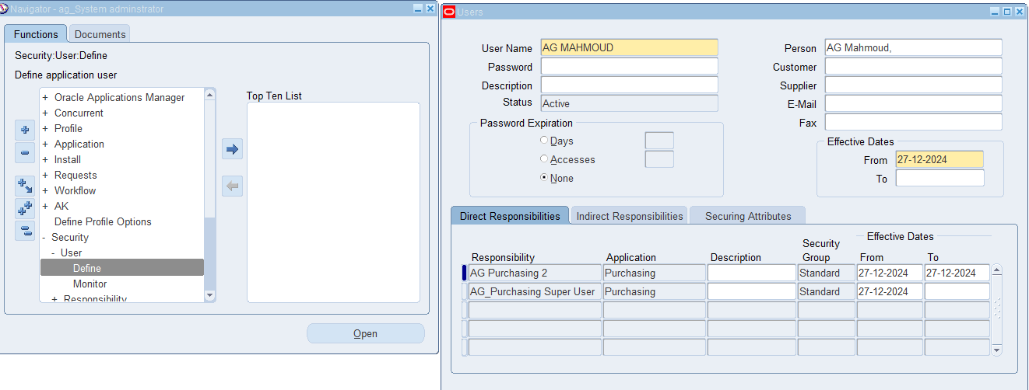
Configuration
2nd Millstone
Define User
System administrator (Resp.)
Security → User → Define

Slide 15
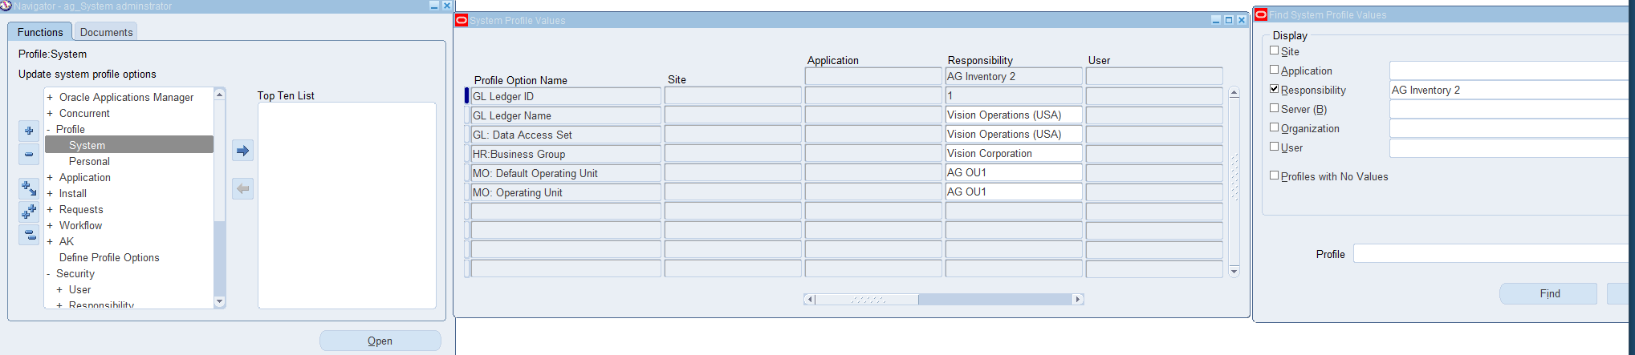
Configuration
2nd Millstone
Profile Options Setup
(General ledger – Purchasing – Inventory – Global HRMS Manager)
System administrator (Resp.)
Profile →System
Operating unit must be defined before Setting profile option of Inventory

Slide 16
Configuration
2nd Millstone
HRMS Manager Setup

Slide 17
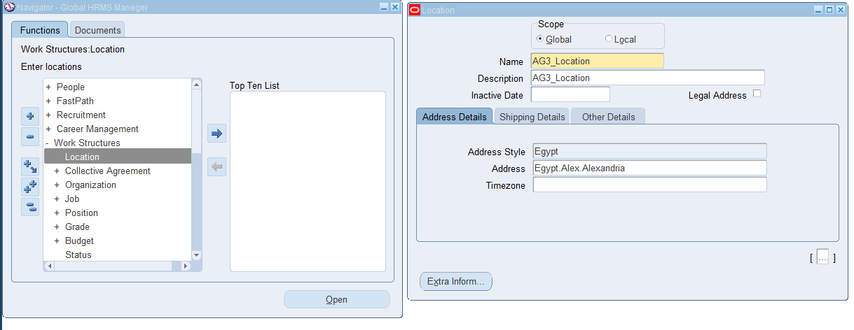
Configuration
2nd Millstone
Define Location
Global HRMS Manager
Work Structure → Location

Slide 18
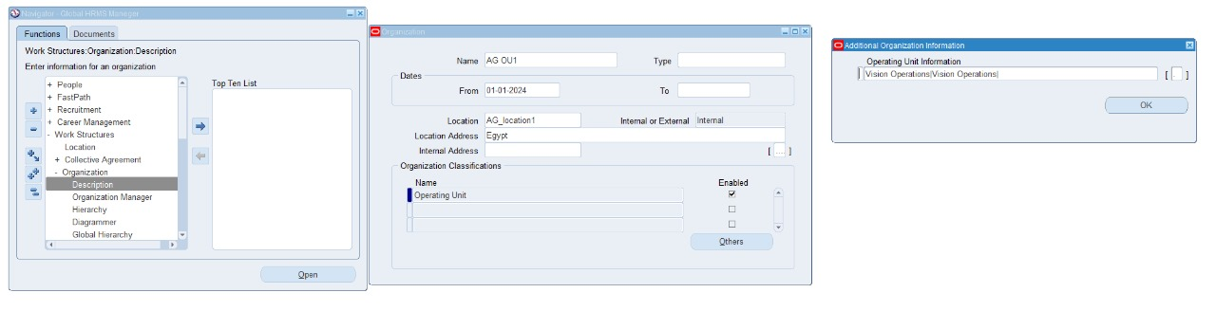
Configuration
2nd Millstone
Define The Operating Unit
Global HRMS Manager
Work Structure → Organization → Description
Note:
Run Organization replicate seed data request after OU defining
Notes:
Add others page

Slide 19
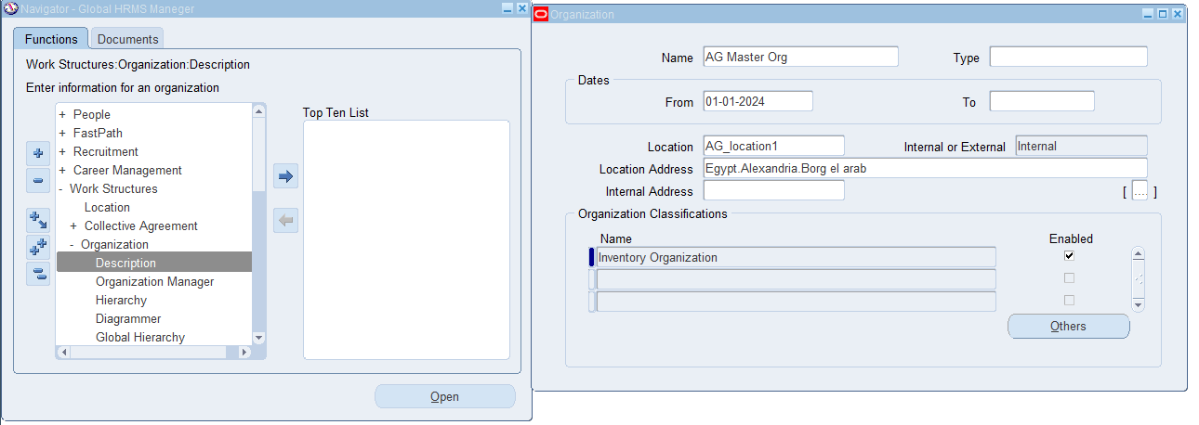
Configuration
2nd Millstone
Define The Master inventory Organization
Global HRMS Manager
Work Structure → Organization → Description

Slide 20
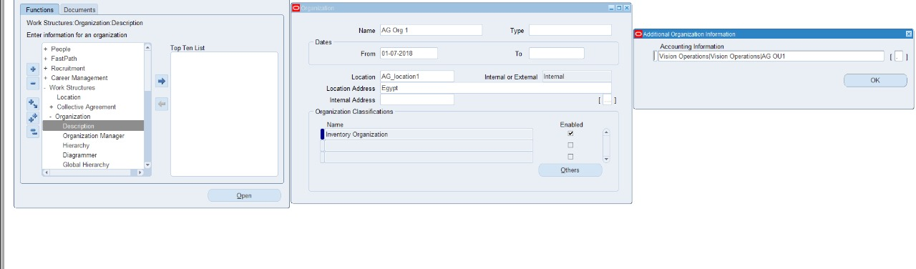
Configuration
2nd Millstone
Define The Inventory Organization
Global HRMS Manager
Work Structure → Organization → Description
Notes:
Add others slide

Slide 21
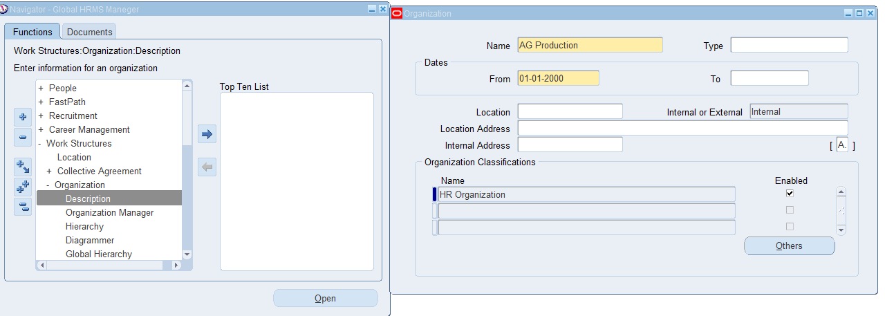
Configuration
2nd Millstone
Define Department
Global HRMS Manager
Work Structure → Organization → Description

Slide 22
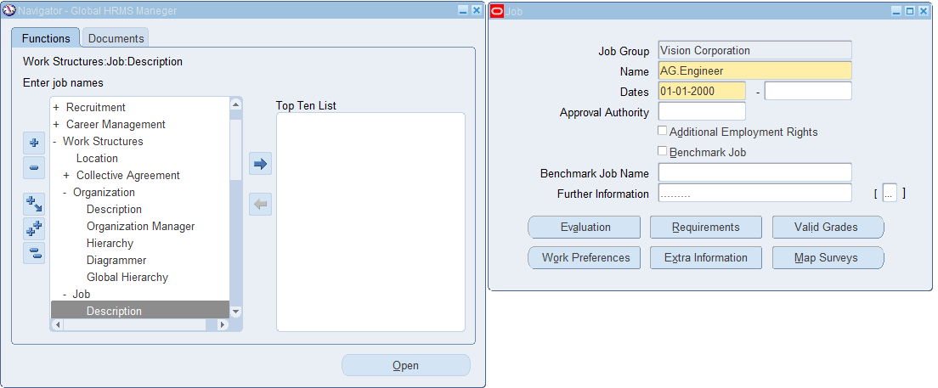
Configuration
2nd Millstone
Define Job Description
Global HRMS Manager
Work Structure → Job → Description

Slide 23
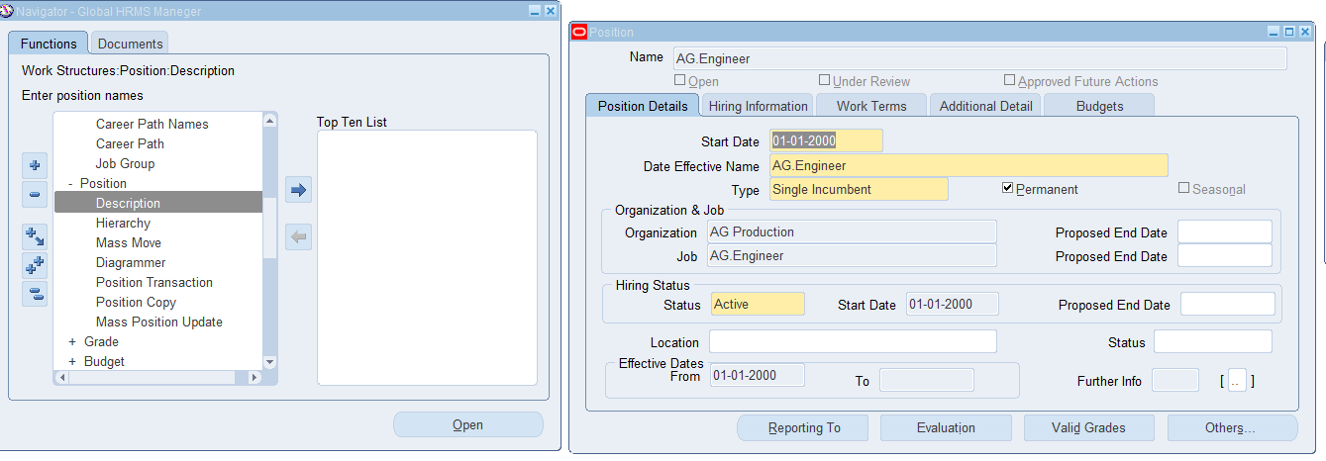
Configuration
2nd Millstone
Define Position Description
Global HRMS Manager
Work Structure → Position → Description

Slide 24
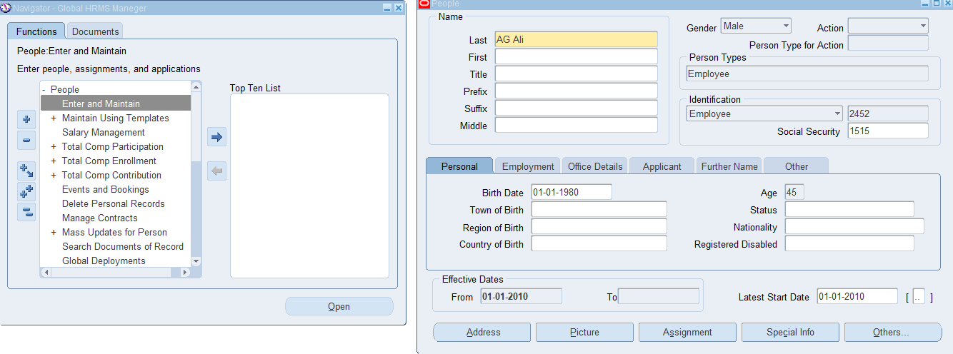
Configuration
2nd Millstone
Define People
Global HRMS Manager
People → Enter and Maintain

Slide 25
Configuration
2nd Millstone
Inventory Setup

Slide 26
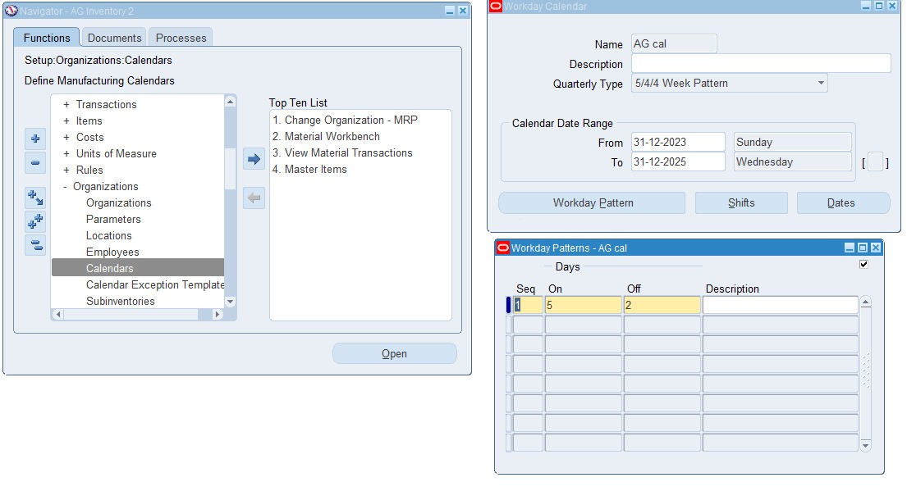
Configuration
2nd Millstone
Define Workday Calendar
AG Inventory 2 (Resp.)
Setup → Organization → Calendars

Slide 27
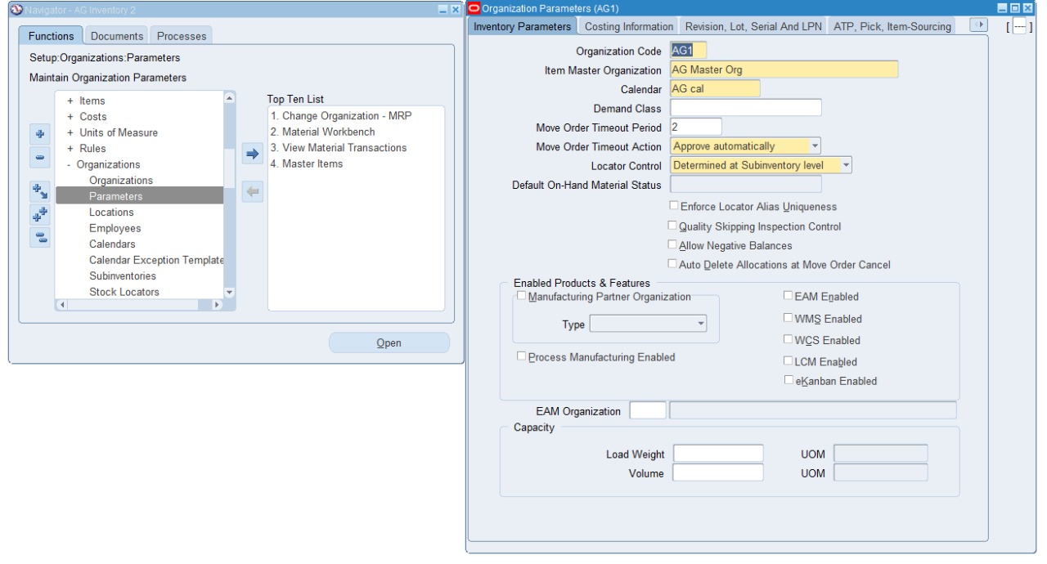
Configuration
2nd Millstone
Define Organization Parameters (Inventory Organization)
AG Inventory 2 (Resp.)
Organizations → Parameters

Slide 28
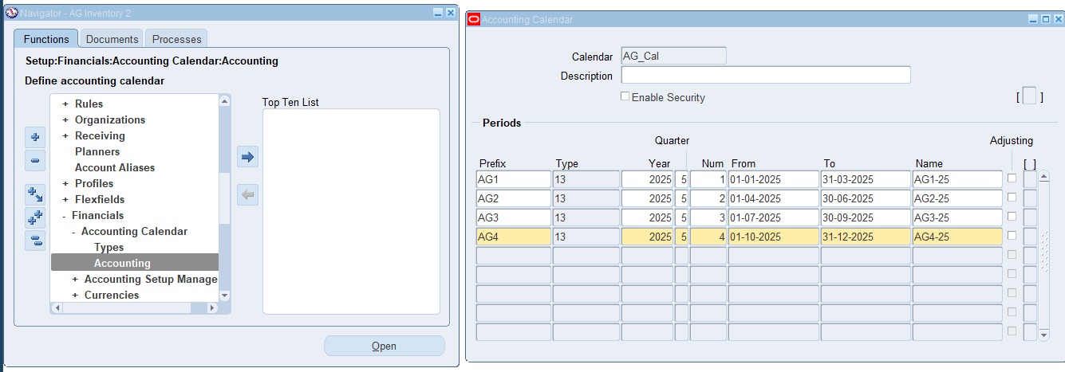
Configuration
2nd Millstone
Define Accounting Calendar
AG Inventory 2 (Resp.)
Setup → Financial → Accounting Calendar → Accounting

Slide 29
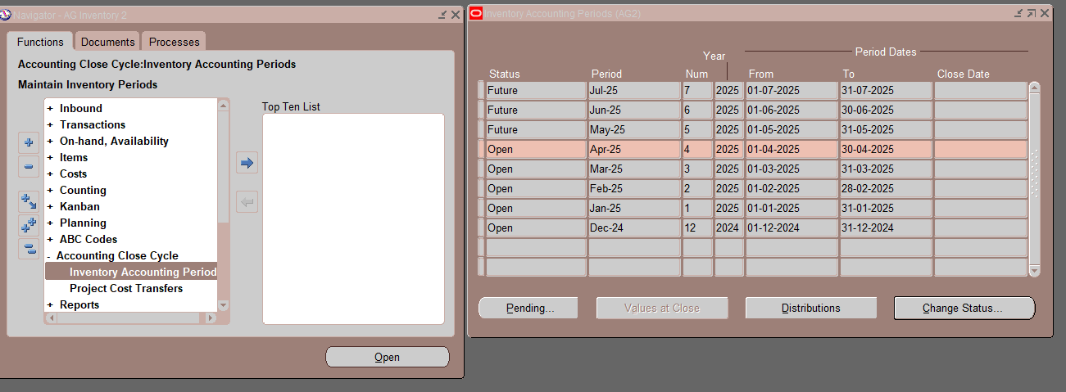
Configuration
2nd Millstone
Define Inventory Accounting period
AG Inventory 2 (Resp.)
Accounting Close Cycle → Inventory Accounting periods

Slide 30
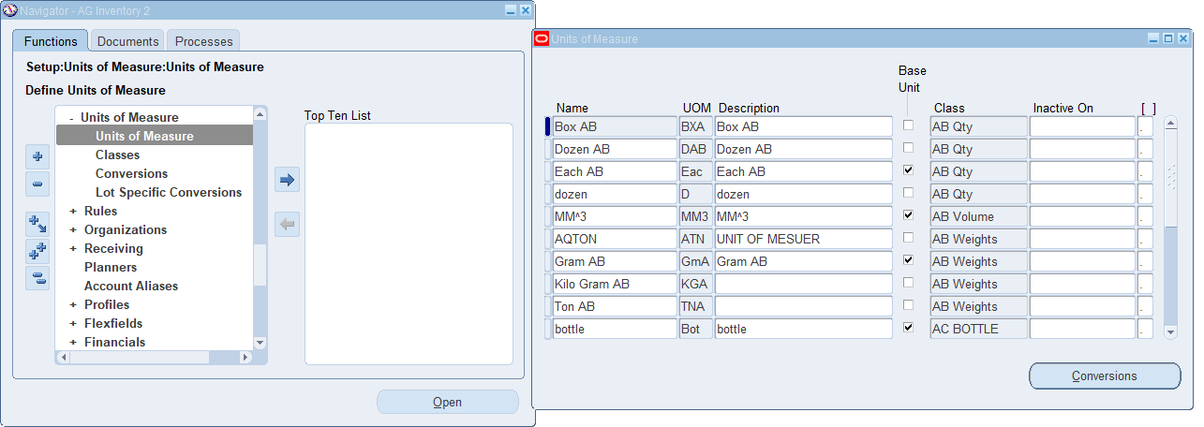
Configuration
2nd Millstone
Define Unit Of Measure
AG Inventory 2 (Resp.)
Setup → Unit of measure → Unit of measure

Slide 31
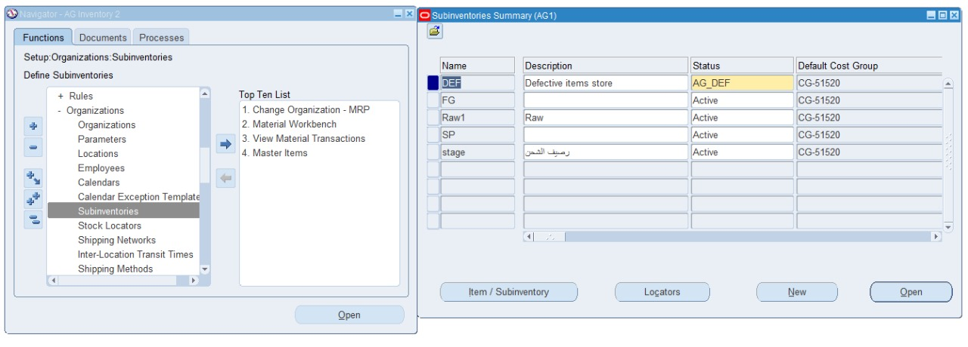
Configuration
2nd Millstone
Define Sub Inventory
AG Inventory 2 (Resp.)
Setup → Sub Inventory

Slide 32
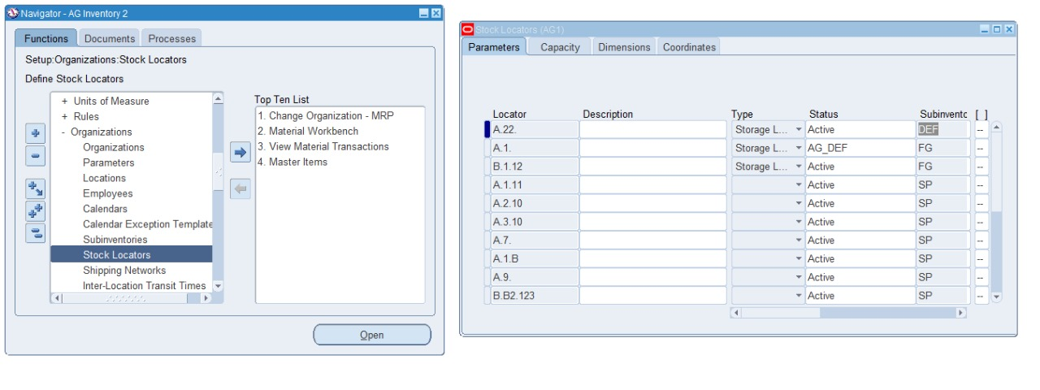
Configuration
2nd Millstone
Define Locators
AG Inventory 2 (Resp.)
Setup → Organizations → Stock Locator

Slide 33
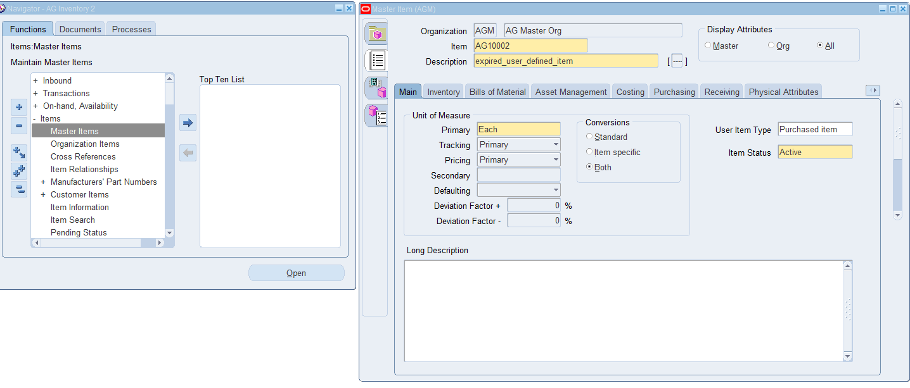
Configuration
2nd Millstone
Define Master Items
AG Inventory 2 (Resp.)
Items → Master Items

Slide 34
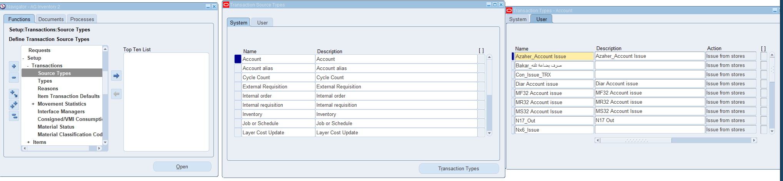
Configuration
2nd Millstone
Define Transaction Source Type
AG Inventory 2 (Resp.)
Setup → Source types

Slide 35
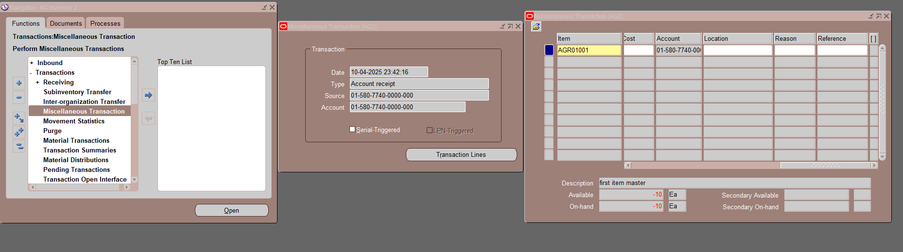
Configuration
2nd Millstone
Make Miscellaneous transaction
Add Items to inventory
AG Inventory 2 (Resp.)
Transactions → Miscellaneous transaction

Slide 36
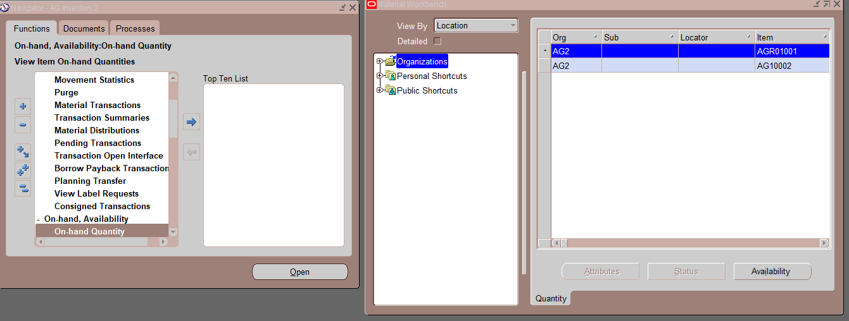
Configuration
2nd Millstone
Material workbench
On Hand Quantity
AG Inventory 2 (Resp.)
On Hand Availability → On hand quantity

Slide 37
Configuration
2nd Millstone
Purchasing Setup

Slide 38
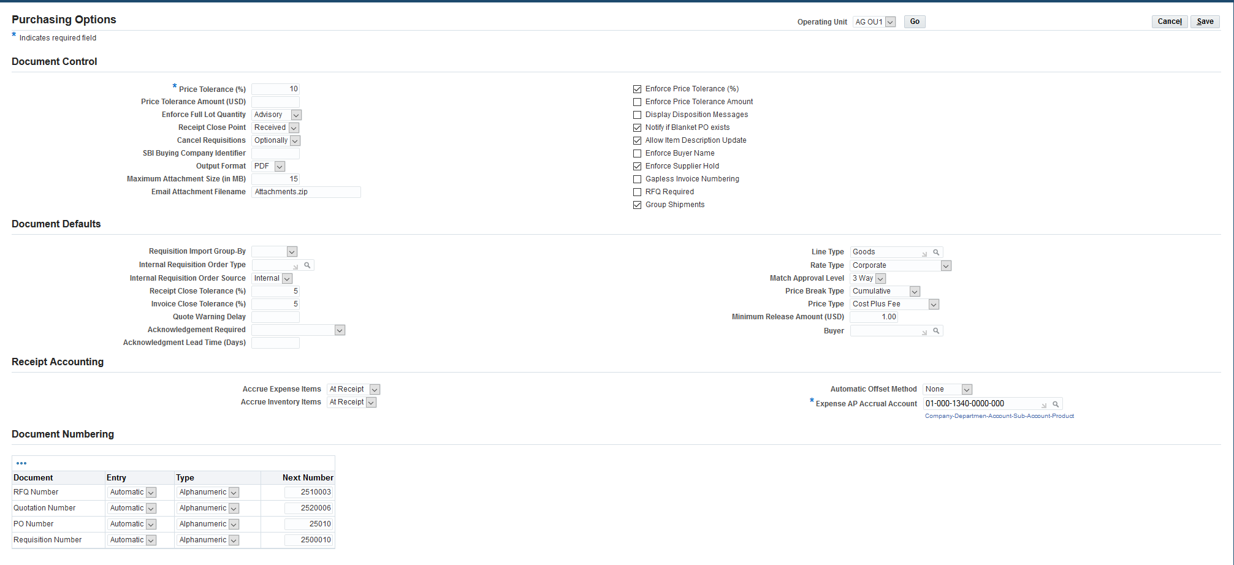
Configuration
2nd Millstone
Purchasing Options Setup
AG purchasing 2 (Resp.)
Setup → Organizations → Purchasing Options

Slide 39
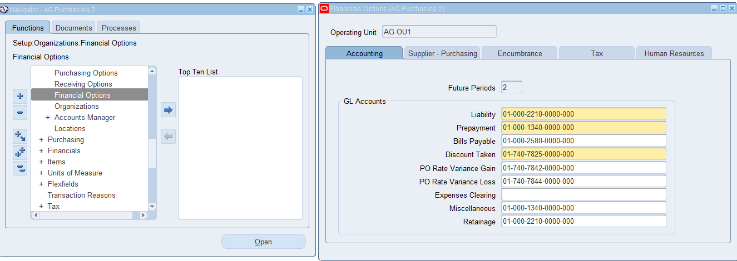
Configuration
2nd Millstone
Financial Options Setup
AG purchasing 2 (Resp.)
Setup → Organizations → Financial Options

Slide 40
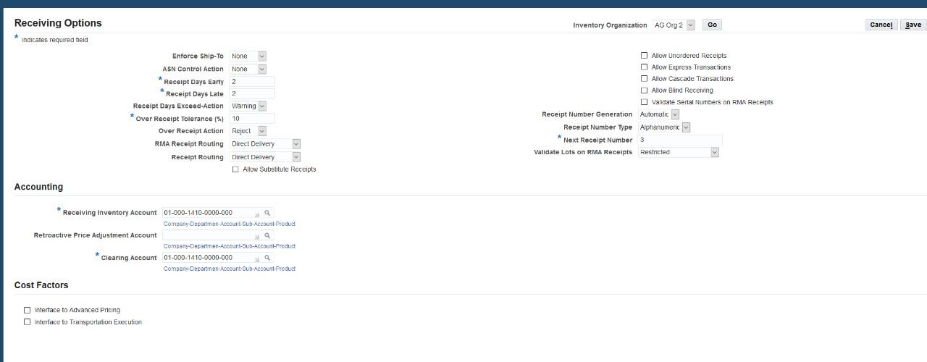
Configuration
2nd Millstone
Receiving Options Setup
AG purchasing 2 (Resp.)
Setup → Organizations → Receiving Options

Slide 41
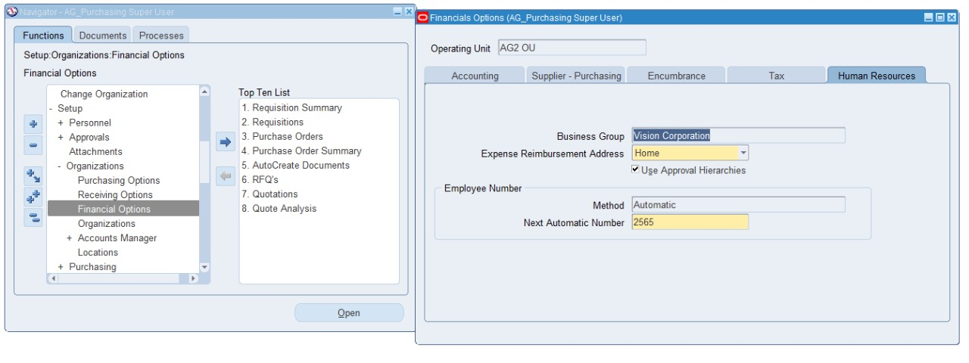
Configuration
2nd Millstone
Position Hierarchy Setup
AG_Purchasing Super User (Resp.)
Setup → Organization → Financial Option

Slide 42
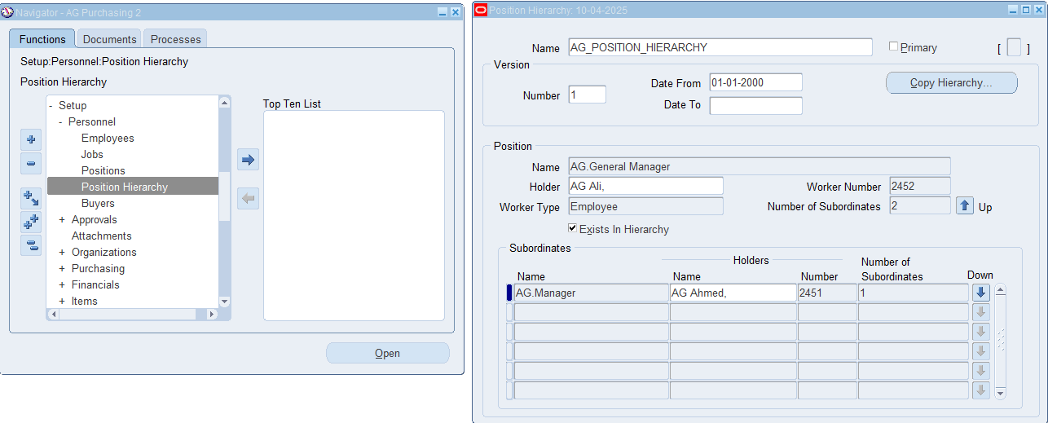
Configuration
2nd Millstone
Position Hierarchy Setup
AG purchasing 2 (Resp.)
Setup → Personnel → Position Hierarchy

Slide 43
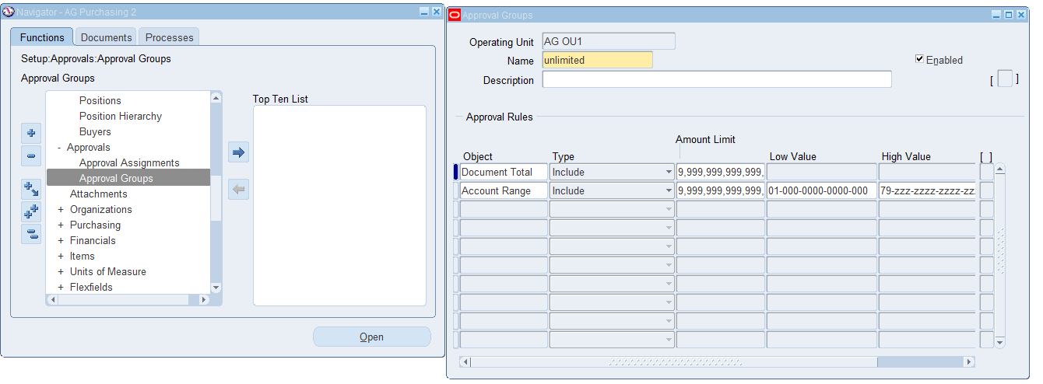
Configuration
2nd Millstone
Approval Group Setup
AG purchasing 2 (Resp.)
Setup → Approvals → Approval Group

Slide 44
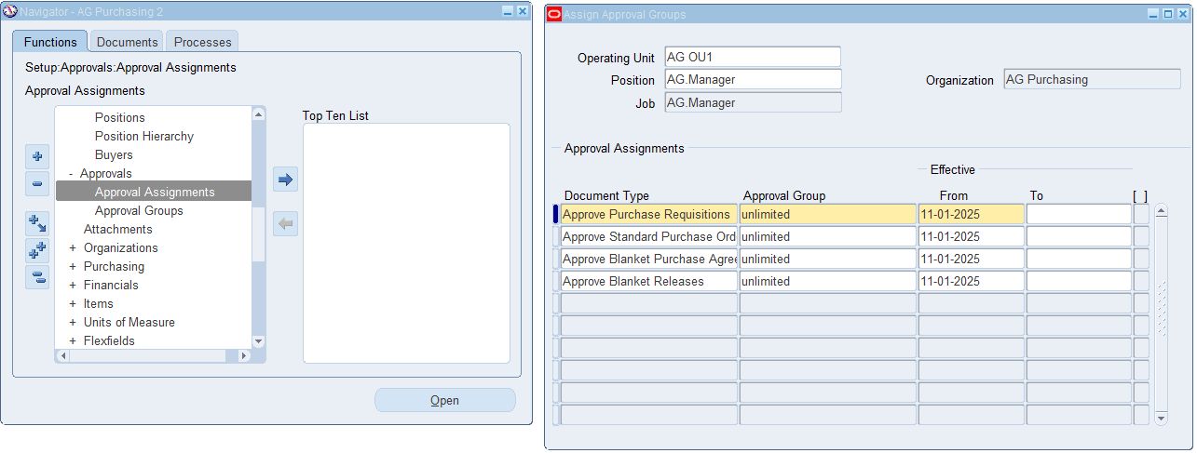
Configuration
2nd Millstone
Approval Assignment Setup
AG purchasing 2 (Resp.)
Setup → Approvals → Approval Assignment

Slide 45
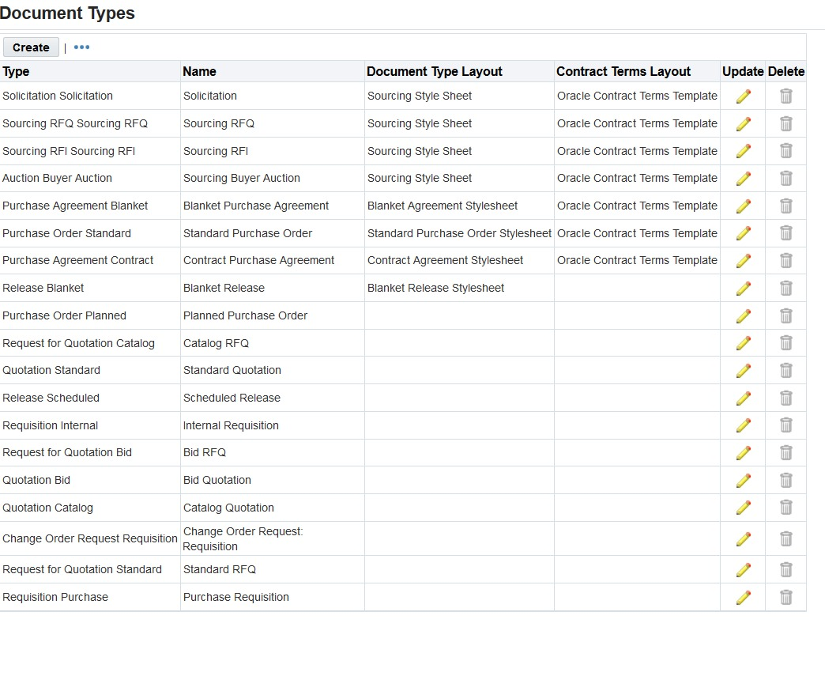
Configuration
2nd Millstone
Update Document Type
AG Purchasing 2 (Resp.)
Setup → Purchasing Options → Document Types

Slide 46
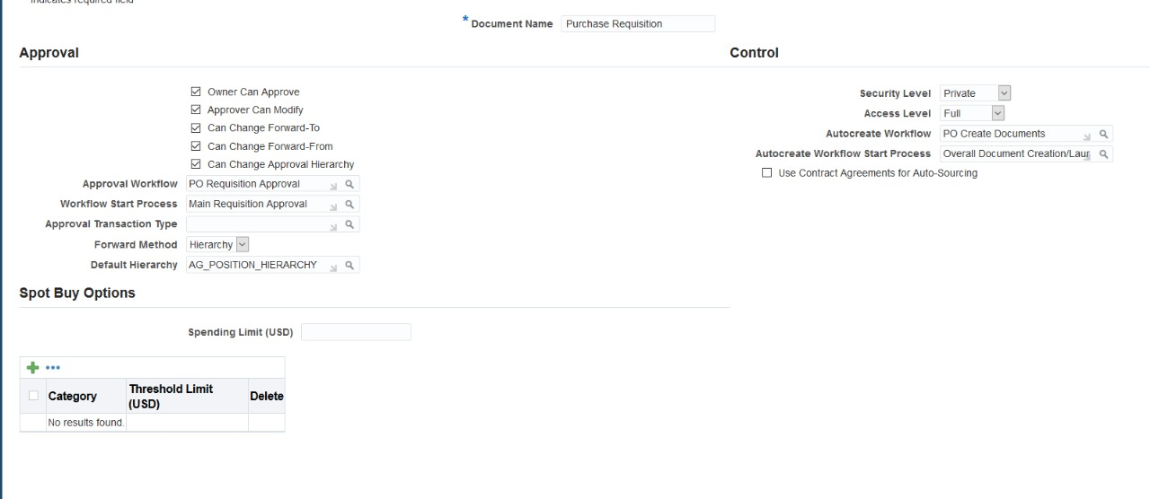
Configuration
2nd Millstone
Update Document Type
Purchase Requisition
AG Purchasing 2 (Resp.)
Setup → Purchasing Options → Document Types

Slide 47
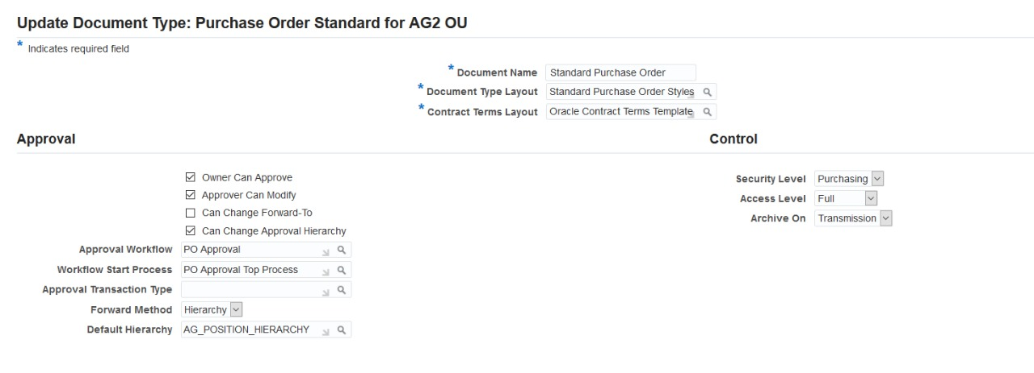
Configuration
2nd Millstone
Update Document Type
Purchase Order
AG Purchasing 2 (Resp.)
Setup → Purchasing Options → Document Types

Slide 48
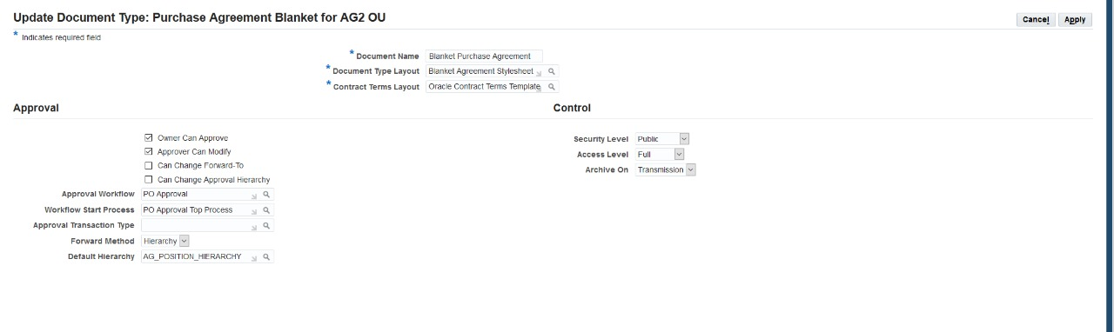
Configuration
2nd Millstone
Update Document Type
Blanket Agreement
AG Purchasing 2 (Resp.)
Setup → Purchasing Options → Document Types

Slide 49
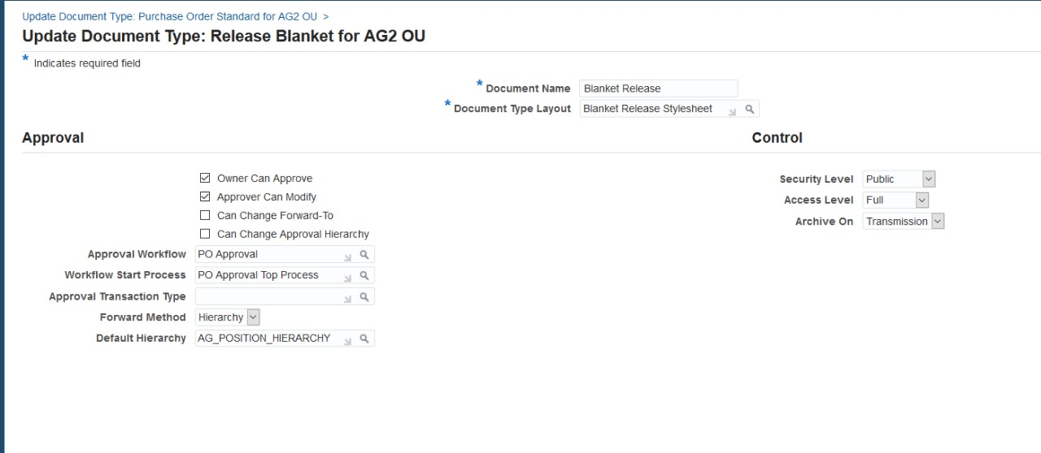
Configuration
2nd Millstone
Update Document Type
Blanket Release
AG Purchasing 2 (Resp.)
Setup → Purchasing Options → Document Types

Slide 50
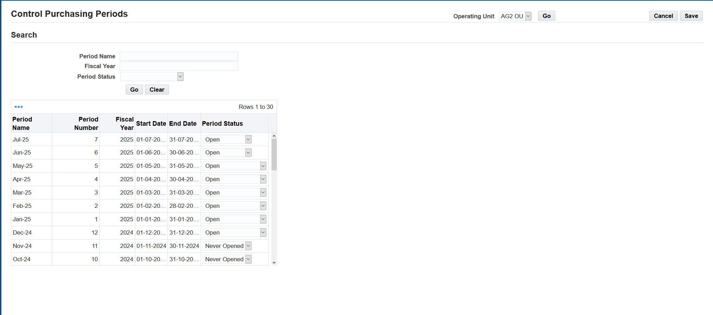
Configuration
2nd Millstone
Control Purchasing Period
AG Purchasing 2 (Resp.)
Setup → Financial → Accounting → Control Purcahsing Period

